Slide 1

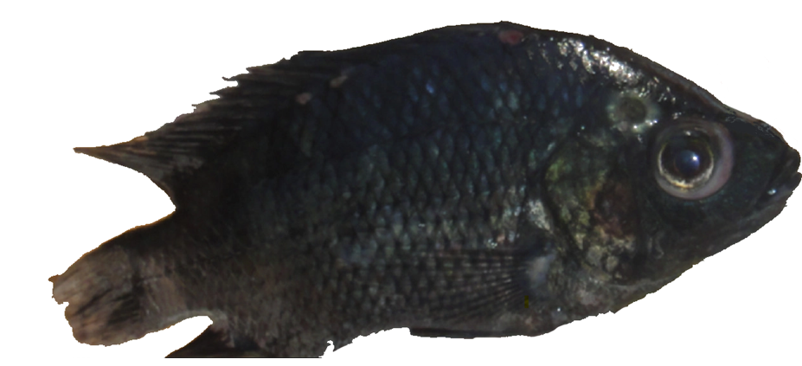
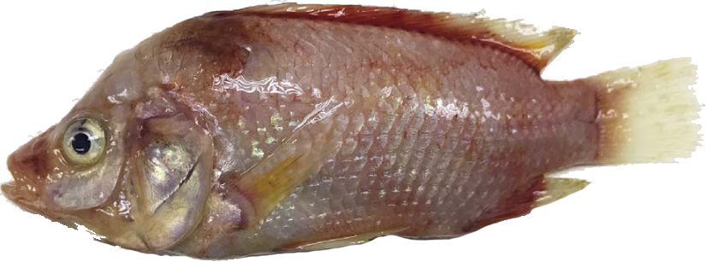
Systemic and mucosal immune responses of Nile tilapia to monovalent and bivalent vaccines against bacteria Streptococcus agalactiae and Aeromonas veronii.
MASTER RESEARCH PROJECT PROPOSAL
Quentin ANDRES
MSc. Aquaculture and Aquatic Resources Management @Asian Institute of Technology, Pathum Thani, Thailand
September 2021
Notes:
Photo on the left from: https://onlinelibrary.wiley.com/doi/abs/10.1111/jfd.12493
Photo on the right: google photos, unspecified.

Slide 2
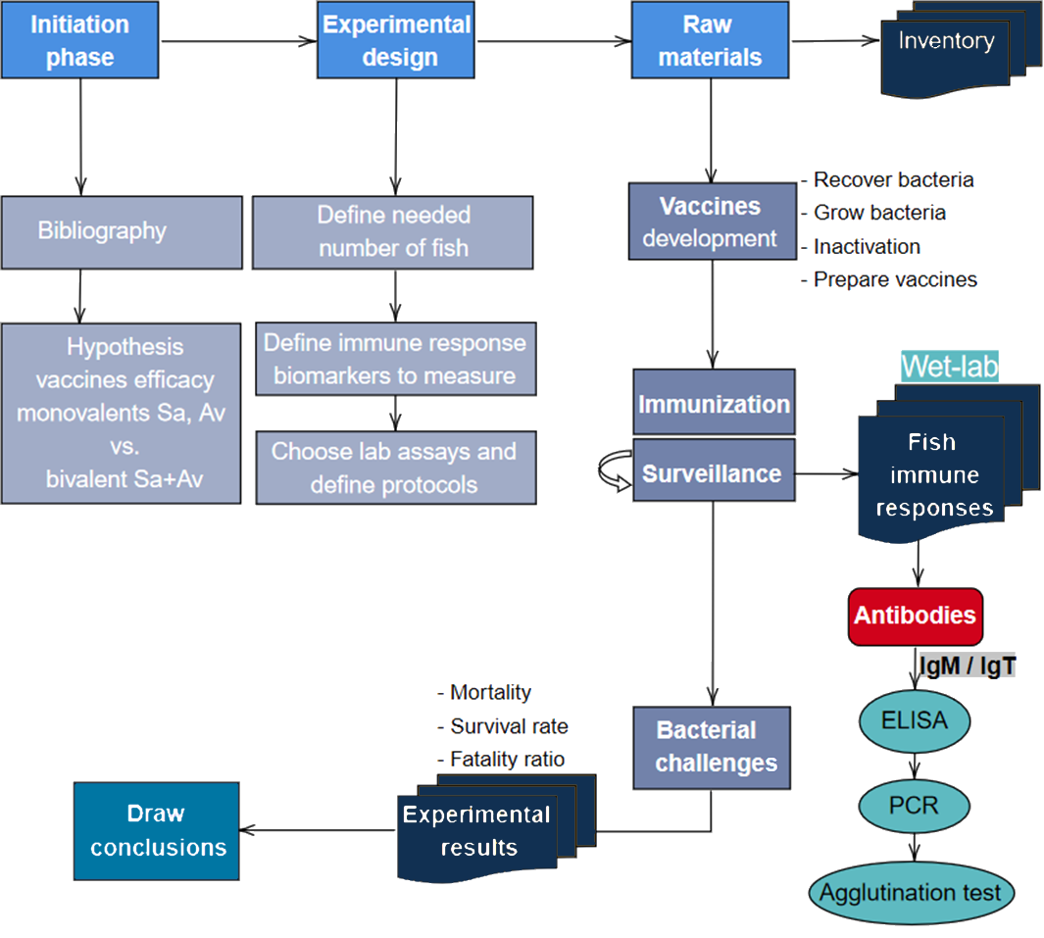
Conceptual framework
S
1+2

Slide 3
WP1 - Pond, fish and husbandry
TASK 1.1: Prepare the 4 aquaria.
TASK 1.2: Assess population distribution parameters
WP3 - Immunization and fish swabs
TASK 1.3: Stock 120 juveniles fish of 12-13 grams per aquarium.
TASK 1.4: Record water parameter.
WP2 - Bacterial preparation, vaccine preparation
TASK 1.6: Acclimate 10 days.
TASK 2.1: Recovery of the two strains
TASK 2.2: Stockage of bacteria for challenge test
TASK 2.3: Production of vaccine Sa
TASK 2.4: Production of vaccine Av
TASK 2.5: Production of vaccine Sa + Av
TASK 2.6: Production of vaccine Control
TASK 3.1: Fish swab before immunization - (baseline IgM)
TASK 3.2: Immunization (Sa, Av, Sa + Av, Control)
TASK 3.3-3.5: Weekly fish swabs to collect biomarkers
WP4 – Lab assays to monitor immune response
TASK 4.1: ELISA for each group of samples for IgM and IgT
TASK 4.2: PCR of key immune genes
TASK 4.3: Agglutination tests
TASK 4.4: Collect and analyse results
TASK 4.5: Draw conclusions
WP5- Challenge test week 4 post vaccination
TASK 5.1: Expose to Steptoccocus agalactiae the group vaccinated with Sa
TASK 5.3: Expose to Aeromonas veronii the group vaccinated with Av
TASK 5.4: Expose to PBS the group vaccinated with Av
WP6 - Ethics requirements
TASK 6.1: Approve use of fish for the study by Animal Care and Use Committee
TASK 5.2: Expose to PBS the group vaccinated with Sa
TASK 6.2: Ensure animal welfare during experimentation
TASK 5.5: Expose to Steptoccocus agalactiae the group vaccinated with Sa + Av
TASK 5.6: Expose to Aeromonas veronii the group vaccinated with Sa + Av
TASK 5.7: Expose to PBS the group vaccinated with Sa + Av
TASK 5.9: Draw conclusions
TASK 5.8: Daily monitoring survival rate
TASK 1.5: Define feeding regime.
TASK 1.7: Bacterial isolation: fish is free of diseases
TASK 3.6: Immunization booster (Sa, Av, Sa + Av, Control)
TASK 3.7-3.14: Weekly fish swabs to collect biomarkers
WP5’- Challenge test (end of experiment)
TASK 5.1: Expose to Steptoccocus agalactiae the group vaccinated with Sa
TASK 5.2: Expose to PBS the group vaccinated with Sa
TASK 5.3: Expose to Aeromonas veronii the group vaccinated with Av
TASK 5.4: Expose to PBS the group vaccinated with Av
TASK 5.5: Expose to Steptoccocus agalactiae the group vaccinated with Sa + Av
TASK 5.6: Expose to Aeromonas veronii the group vaccinated with Sa + Av
TASK 5.7: Expose to PBS the group vaccinated with Sa + Av
TASK 5.8: Daily monitoring survival rate
TASK 5.9: Draw conclusions
NOT STARTED
ON-GOING
COMPLETED
AT RISK
Work packages
and tasks

Slide 4
WP1 - Pond, fish and husbandry
WP2 - Bacterial preparation, vaccine preparation
WP4 - Lab assays to monitor immune response
WP3 - Immunization, fish swab
WP5 – Challenge tests
Prepare pond, stock breeders, select feeding regime
Prepare at least 9 small ponds for the challenge test
Quality control, fish free of diseases
Feed the offspring and raise 400 juveniles
Workflow and work
packages
Expose to Av strain the group vaccinated with Sa+Av
Prepare 4 medium experimental ponds for Ct, Sa, Av, Sa+Av
Baseline biomarkers titers before challenge test
Expose to Sa strain the group vaccinated with Sa+Av
Acclimation 10-14 days
ELISA for IgM and IgT
Expose to Av strain the group vaccinated with Av
Quality control, fish free of diseases
PCR of key immune genes
Perform challenge test 1 (week4 pv)
Expose to Sa strain the group vaccinated with Sa
Fish swab before immunization - baseline biomarkers titers
Agglutination test
Perform challenge test 2 (week 12 pv)
Expose unvaccinated group to Av
Expose unvaccinated group to Sa
Recovery of the two bacterial strains, amplification and culture
Stockage of bacteria for challenge test
Control groups
Daily monitoring survival rate
Production of vaccine Sa
Production of vaccine Av
Production of vaccine Sa+Av
Production of vaccine Control (PBS)
Collect and analyse results
Immunization (Sa, Av, Sa + Av, Control)
Weekly fish swabs to collect biomarkers
ELISA for IgM and IgT
PCR of key immune genes
Agglutination test
Draw conclusions
Experimental design ->

Slide 5
Vaccinated tilapia (Sa+Av)
n = 165 fish
m = 13 ± 2g
Vaccinated tilapia (Sa)
n = 165 fish
m = 13 ± 2g
Vaccinated tilapia (Av)
n = 165 fish
m = 13 ± 2g
Un-vaccinated tilapia (PBS)
n = 165 fish
m = 13 ± 2g
Bacterial isolation
Sa-free & Av-free
Acclimatation 10 days at RT
Examine fish and feed 3%BW
Record events / abnormalities
Group SaAv
Group Sa
Group Av
Group PBS
Injection 100u IP vaccine
Injection 100u IP vaccine
Injection 100u IP vaccine
Injection 100u IP
PBS
Sampling:
Blood & mucus ELISA for IgM levels. N=8fish/tank
Head kidney & spleen PCR for gene expression
N=3 fish/tank
Every week for 12 weeks
First vaccination (day 0) &
Second vaccination
(day 21)
Subgroup SaAv 1
N = 60
Subgroup SaAv 2
N = 60
Subgroup
Sa 1
N = 60
Subgroup Sa 2
N = 60
SubgroupAv 1
N = 60
Subgroup Av 2
N = 60
Subgroup
PBS 1
N = 60
Subgroup PBS 2
N = 60
Move subgroup to challenge tanks
+Sa 4
N =15
+Sa 4
N =15
+Sa 4
N =15
+Sa 12
N =15
+Sa 12
N =15
+Sa
10^6C/ml IP
+Sa 12
N =15
Challenge
(week 4)
+Sa 4’
N =15
+Sa 4’
N =15
+Sa 4’
N =15
Challenge
(week 12)
+Sa 12’
N =15
+Sa 12’
N =15
+Sa 12’
N =15
+Av 4
N =15
+Av 4
N =15
+Av 4
N =15
Record events / abnormalities
Record mortality
Remove dead fish
+Av 12
N =15
+Av
10^6C/ml IP
+Av 12
N =15
+Av 12
N =15
Challenge
(week 4)
+Av 4’
N =15
+Av 4’
N =15
+Av 4’
N =15
Challenge
(week 12)
+Av 12’
N =15
+Av 12’
N =15
+Av 12’
N =15
At 12 weeks p.v.
m = 20 ± 2g

Slide 6





Project Planning Timeline
Today
August |  |  | September |  |  |  |  |  |  |  |  |  |  |  |  |  |  |  |  |  |  |  |  |  |  |  |  |  |  |  |  |  | Oct
Dates | 2021
 | 30 | 31 | 1 | 2 | 3 | 4 | 5 | 6 | 7 | 8 | 9 | 10 | 11 | 12 | 13 | 14 | 15 | 16 | 17 | 18 | 19 | 20 | 21 | 22 | 23 | 24 | 25 | 26 | 27 | 28 | 29 | 30 | 1 | 2
Project Day | M | T | W | T | F | S | S | M | T | W | T | F | S | S | M | T | W | T | F | S | S | M | T | W | T | F | S | S | M | T | W | T | F | S
Project Week |  |  |  |  |  |  |  |  |  | S | T | A | R | T | 1 |  |  |  |  |  |  | 2 |  |  |  |  |  |  | 3
Phase one
Project Conception Definition Planning Initiation
Phase Two
Pond/fish Bacterial recovery Bacterial preparation Fish swabs Immunization
Phase Three
Challenge tests Lab assays ELISA & PCR Bacteriology Draw results Conclusions
Main Review
Scope and Goal Setting
Work Bkdwn Structure
Initiation
Prepare ponds and acclimate 7 days
Recover the two bacterial strains 1 day
Culture bacteria
Produce vaccine
Immunization 1
Fish swabs 1
Fish swabs 2
Bacterial isolation on 5 fish.

Slide 7

Project Planning Timeline
September |  |  | October |  |  |  |  |  |  |  |  |  |  |  |  |  |  |  |  |  |  |  |  |  |  |  |  |  |  |  |  |  | Nov
Dates | 2021
 | 29 | 30 | 1 | 2 | 3 | 4 | 5 | 6 | 7 | 8 | 9 | 10 | 11 | 12 | 13 | 14 | 15 | 16 | 17 | 18 | 19 | 20 | 21 | 22 | 23 | 24 | 25 | 26 | 27 | 28 | 29 | 30 | 31 | 1
Project Day | W | T | F | S | S | M | T | W | T | F | S | S | M | T | W | T | F | S | S | M | T | W | T | F | S | S | M | T | W | T | F | S | S | M
Project Week |  |  |  |  |  | 3 |  |  |  |  |  |  | 4 |  |  |  |  |  |  | 5 |  |  |  |  |  |  | 6 |  |  |  |  |  |  | 7
Phase one
Project Conception Definition Planning Initiation
Phase Two
Pond/fish Bacterial recovery Bacterial preparation Fish swabs Immunization
Phase Three
Challenge tests Lab assays ELISA & PCR Bacteriology Draw results Conclusions
Immunization 2 Booster of day 21
Fish swabs 3
Fish swabs 4
Fish swabs 5
Fish swabs 6
F
First bacterial challenge

Slide 8
Project Planning Timeline
October |  |  | November |  |  |  |  |  |  |  |  |  |  |  |  |  |  |  |  |  |  |  |  |  |  |  |  |  |  |  |  |  | Dec
Dates | 2021
 | 30 | 31 | 1 | 2 | 3 | 4 | 5 | 6 | 7 | 8 | 9 | 10 | 11 | 12 | 13 | 14 | 15 | 16 | 17 | 18 | 19 | 20 | 21 | 22 | 23 | 24 | 25 | 26 | 27 | 28 | 29 | 30 | 1 | 2
Project Day | S | S | M | T | W | T | F | S | S | M | T | W | T | F | S | S | M | T | W | T | F | S | S | M | T | W | T | F | S | S | M | T | W | T
Project Week |  |  | 7 |  |  |  |  |  |  | 8 |  |  |  |  |  |  | 9 |  |  |  |  |  |  | 10 |  |  |  |  |  |  | 11
Phase one
Project Conception Definition Planning Initiation
Phase Two
Pond/fish Bacterial recovery Bacterial preparation Fish swabs Immunization
Phase Three
Challenge tests Lab assays ELISA & PCR Bacteriology Draw results Conclusions
Fish swabs 7
Fish swabs 8
Fish swabs 9
Fish swabs 10
Fish swabs 11

Slide 9

Project Planning Timeline
November |  |  | December |  |  |  |  |  |  |  |  |  |  |  |  |  |  |  |  |  |  |  |  |  |  |  |  |  |  |  |  |  | Jan
Dates |  |  |  |  |  |  |  |  |  |  |  |  |  |  |  |  |  |  |  |  |  |  |  |  |  |  |  |  |  |  |  |  | 2022
 | 29 | 30 | 1 | 2 | 3 | 4 | 5 | 6 | 7 | 8 | 9 | 10 | 11 | 12 | 13 | 14 | 15 | 16 | 17 | 18 | 19 | 20 | 21 | 22 | 23 | 24 | 25 | 26 | 27 | 28 | C | 30 | 31 | 1
Project Day | M | T | W | T | F | S | S | M | T | W | T | F | S | S | M | T | W | T | F | S | S | M | T | W | T | F | S | S | M | T | W | T | F | S
Project Week | 11 |  |  |  |  |  |  | 12 |  |  |  |  |  |  | 13 |  |  |  |  |  |  | 14 |  |  |  |  |  |  | 15 |  |  | E | N | D
Phase one
Project Conception Definition Planning Initiation
Phase Two |  |  |  |  |  |  |  |  |  |  |  |  |  |  |  |  |  |  |  |  |  |  |  |  |  |  |  |  |  |  |  |  |  | P
Pond/fish Bacterial recovery Bacterial preparation Fish swabs Immunization |  |  |  |  |  |  |  |  |  |  |  |  |  |  |  |  |  |  |  |  |  |  |  |  |  |  |  |  |  |  |  |  |  | R
 |  |  |  |  |  |  |  |  |  |  |  |  |  |  |  |  |  |  |  |  |  |  |  |  |  |  |  |  |  |  |  |  |  | O
 |  |  |  |  |  |  |  |  |  |  |  |  |  |  |  |  |  |  |  |  |  |  |  |  |  |  |  |  |  |  |  |  |  | J
 |  |  |  |  |  |  |  |  |  |  |  |  |  |  |  |  |  |  |  |  |  |  |  |  |  |  |  |  |  |  |  |  |  | E
 |  |  |  |  |  |  |  |  |  |  |  |  |  |  |  |  |  |  |  |  |  |  |  |  |  |  |  |  |  |  |  |  |  | C
Phase Three |  |  |  |  |  |  |  |  |  |  |  |  |  |  |  |  |  |  |  |  |  |  |  |  |  |  |  |  |  |  |  |  |  | T
Challenge tests Lab assays ELISA & PCR Bacteriology Draw results Conclusions
 |  |  |  |  |  |  |  |  |  |  |  |  |  |  |  |  |  |  |  |  |  |  |  |  |  |  |  |  |  |  |  |  |  | E
 |  |  |  |  |  |  |  |  |  |  |  |  |  |  |  |  |  |  |  |  |  |  |  |  |  |  |  |  |  |  |  |  |  | N
 |  |  |  |  |  |  |  |  |  |  |  |  |  |  |  |  |  |  |  |  |  |  |  |  |  |  |  |  |  |  |  |  |  | D
Fish swabs 11
Fish swabs 12
Second bacterial challenge
Lab assays to monitor immune responses
ELISA
PCR
Agglutination
Draw results
Conclude

Slide 10
Thank you !

